Slide 1
Decision Tree

Slide 2
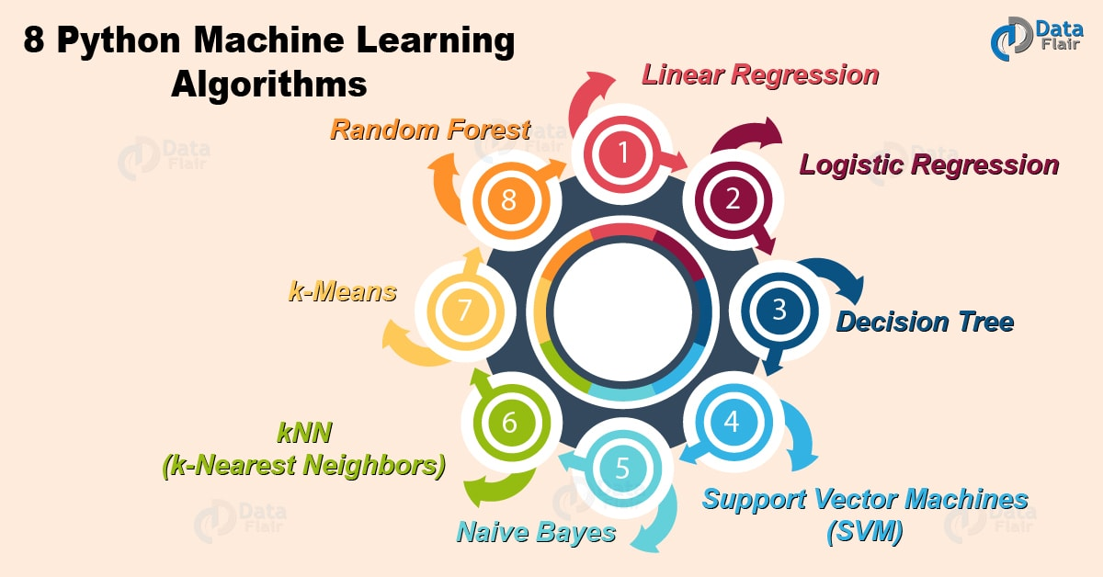
Decision Trees
Introduced in the early 60’s by Morgan & Sonquist
DTs can be used for both classification and regression
DTs are rule based methods.
Easy to understand and interpret
Typical Algorithms:
Decision Trees
Rule-based induction
Neural networks
K-Nearest Neighbor
Random Forests
Bayesian networks
Support Vector Machines
2
Notes:
Decision Trees were introduced in 1963
Decision trees can be used for both regression and classification problems.
Decision trees are robust, easy to implement, understand and interpret
The Department of Statistics at the University of Wisconsin–Madison writes:
that the first decision tree regression was invented in 1963 (AID project, Morgan and Sonquist).

Slide 3
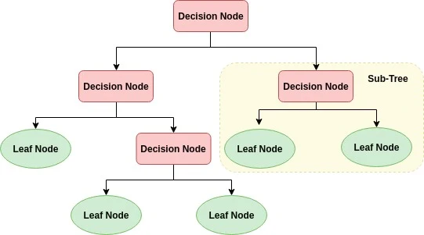
Decision Trees
A decision tree is a flowchart-like tree structure where an (a) internal node represents feature (or attribute), the (b) branch represents a decision rule, each (c) leaf node represents outcome.
This flowchart-like structure helps you in decision making.
It's visualization like a flowchart diagram which easily mimics the human level thinking.
That is why decision trees are easy to understand and interpret.
feature
decision rule
feature
feature
outcome
outcome
3
Notes:
Decision trees are easy to follow and easy to construct since they follow and mimic how we humans think (logical)
The flowchart structure helps the designer:
Understand the different decisions taken by the ML algorithm.
Interpret the results obtained ..
The tree has different types of nodes and a certain depth

Slide 4
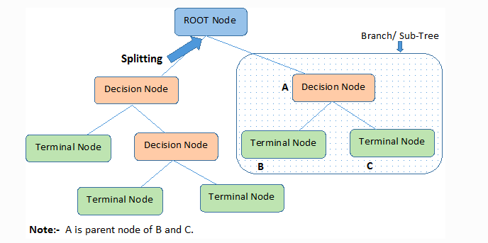
Tree Structure: Root Node
The topmost node in a decision tree is known as the root node.
It learns to partition on the basis of the attribute value.
Different Tree Structures will be formed if different “Features” are used to split the tree at the root.
4
Notes:
The very top node in the tree is the “Root Node”
It is a very important Node since splitting the tree optimally at this stage makes the tree a better ML algorithm
This is part of the learning that occurs in the Tree

Slide 5
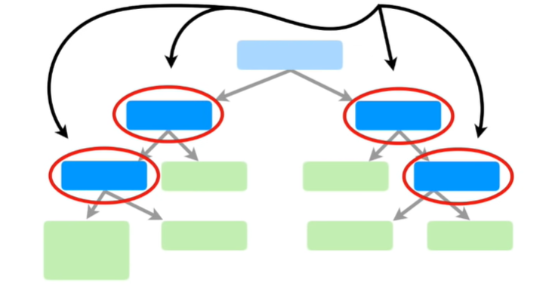
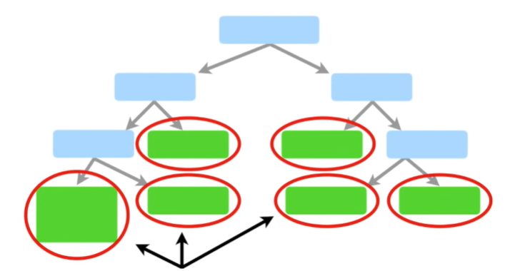
Internal & Leaf Nodes
These are called internal nodes or decision nodes
These are called Leaf Nodes or Terminal Nodes
5
Notes:
Internal Nodes are the Decision Nodes that further split the tree
The terminal nodes are called Leaf Nodes and these nodes have the class answer of the records

Slide 6
Example : Decision?
Homework Deadline tonight?
Yes
No
Do homework
Party invitation?
Yes
No
Do I have friends
Go to the party
Yes
No
Read a book
Hang out with friends
6
Notes:
Example #1, shows how a tree is built based on the features available

Slide 7
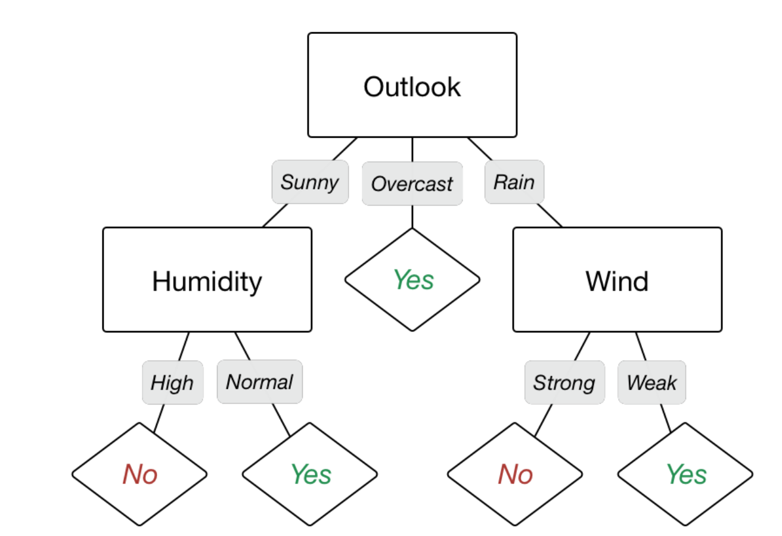
DT: Algorithm
Start with a training data set which we’ll call S. It should have attributes and classification.
Determine the best attribute in the dataset. (We will cover the definition of best attribute)
Split S into subset that contains the possible values for the best attribute.
Make decision tree node that contains the best attribute.
Recursively generate new decision trees by using the subset of data created from step 3 until a stage is reached where you cannot classify the data further. Represent the class as leaf node.
ID code | Outlook | Temperature | Humidity | Windy | Play
a b c d e f g h i j k l m n | Sunny Sunny Overcast Rainy Rainy Rainy Overcast Sunny Sunny Rainy Sunny Overcast Overcast Rainy | Hot Hot Hot Mild Cool Cool Cool Mild Cool Mild Mild Mild Hot Mild | High High High High Normal Normal Normal High Normal Normal Normal High Normal High | False True False False False True True False False False True True False True | No No Yes Yes Yes No Yes No Yes Yes Yes Yes Yes No
7
Notes:
We start to build the tree by checking all the features and how well they split the tree
By looking at one of the measures used to split trees we find that “Outlook” is the best feature to use at the Root.
In some cases we end up with a leaf (such as Overcast) since there is always a single outcome
The next feature chosen on the left hand side is “Humidity” since it gives the best split
A Complete tree constructed from the data

Slide 8
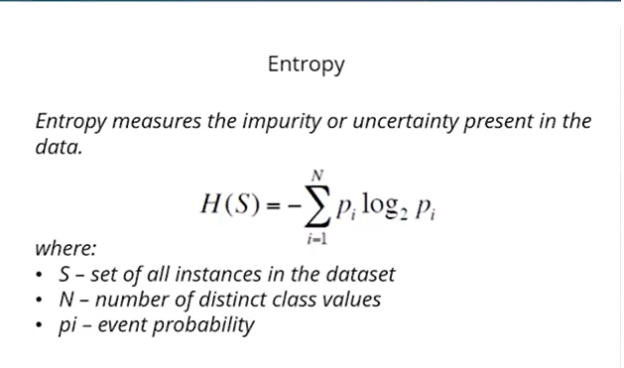
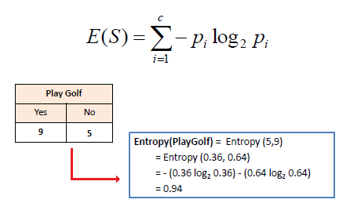

Slide 9
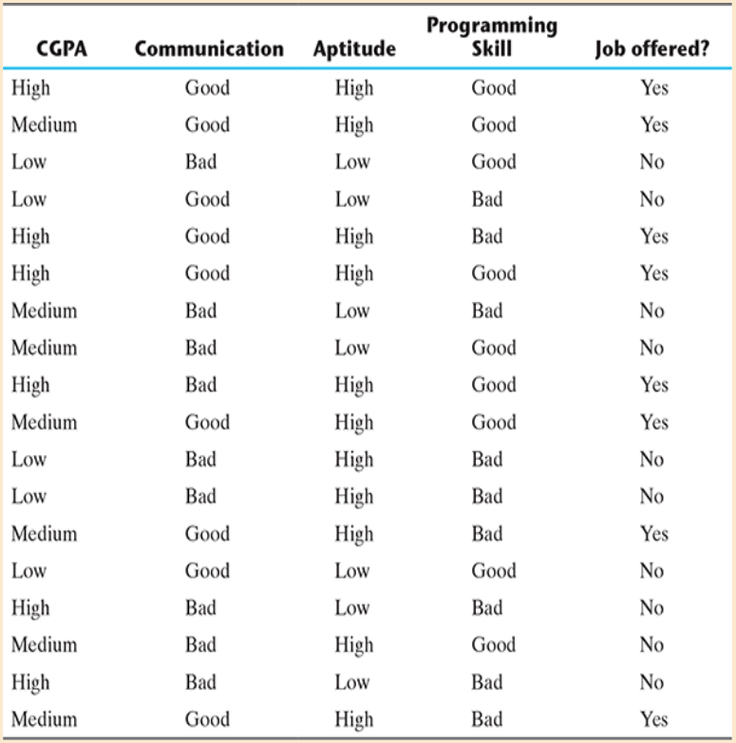

Slide 10
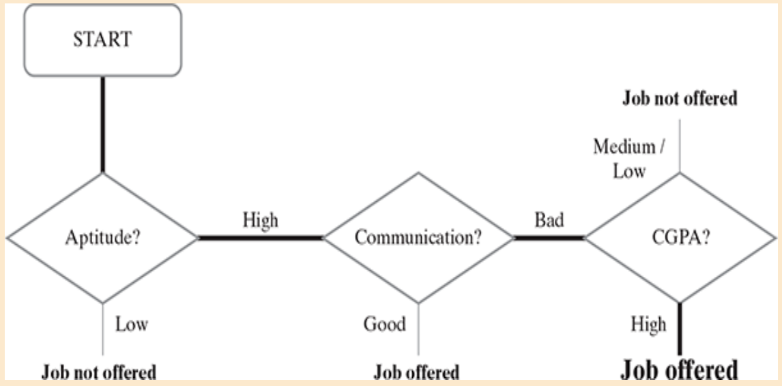

Slide 11
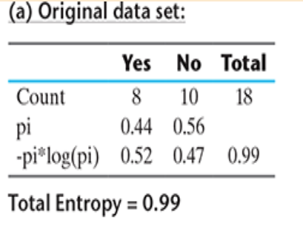
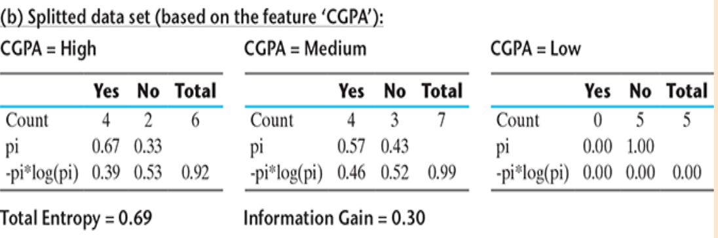

Slide 12
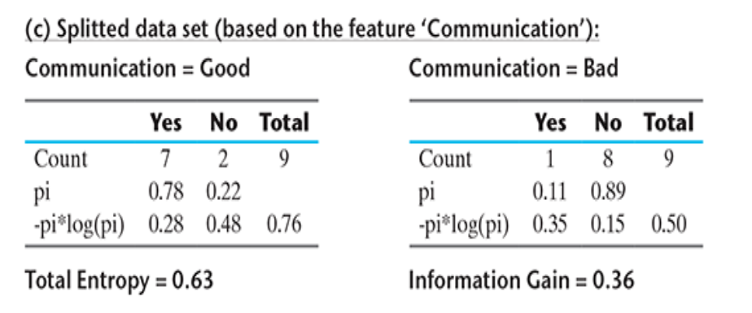
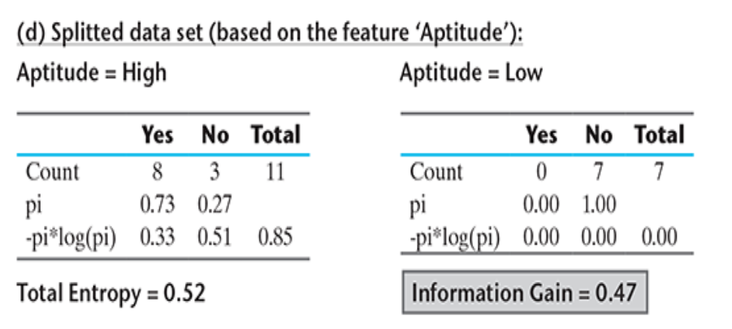
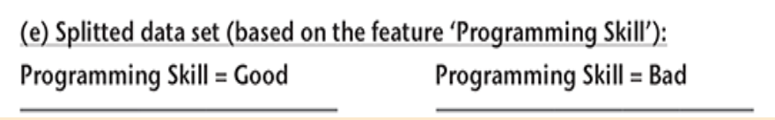
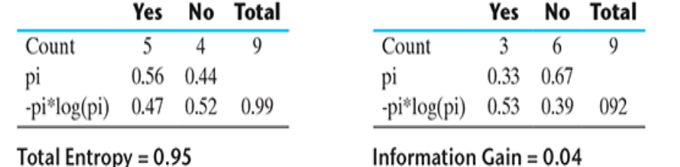

Slide 13
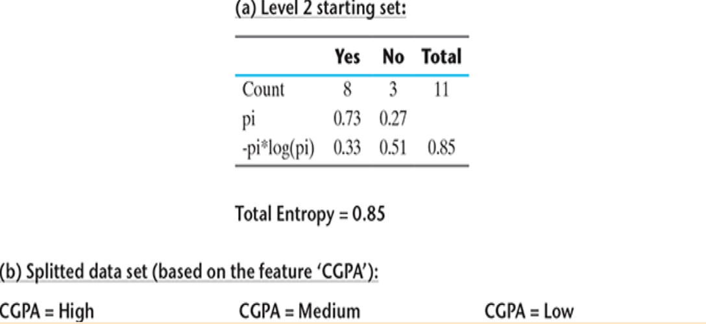
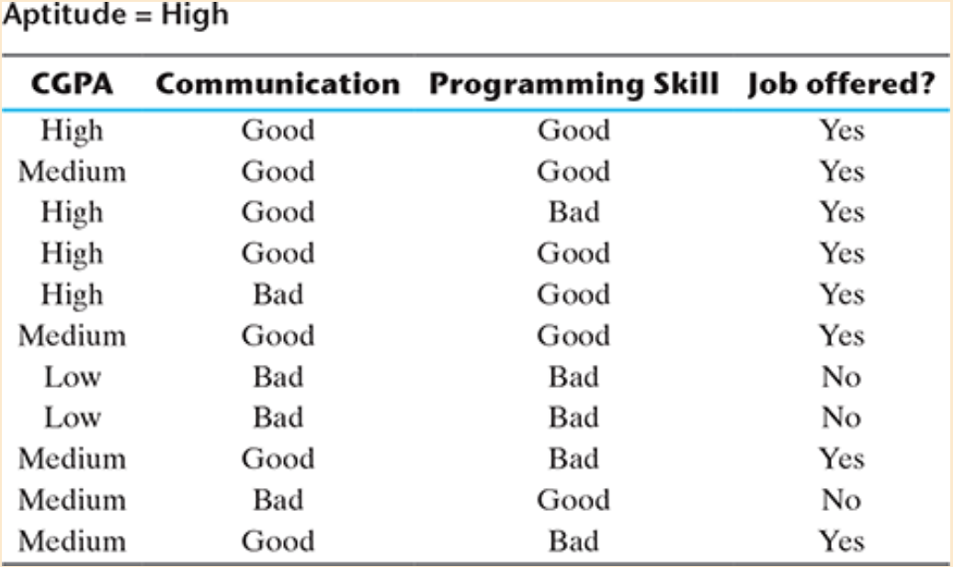
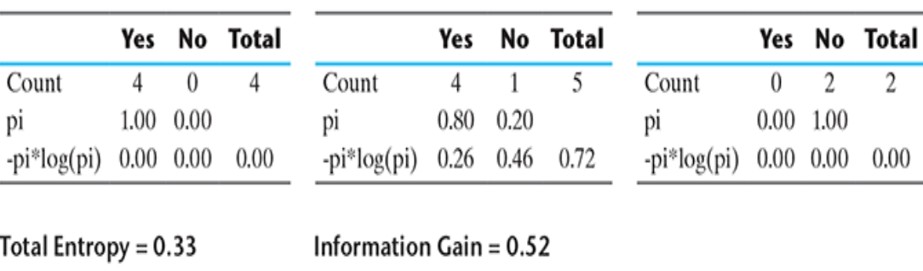

Slide 14
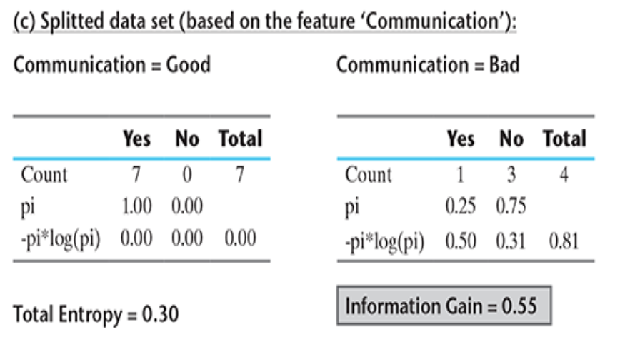
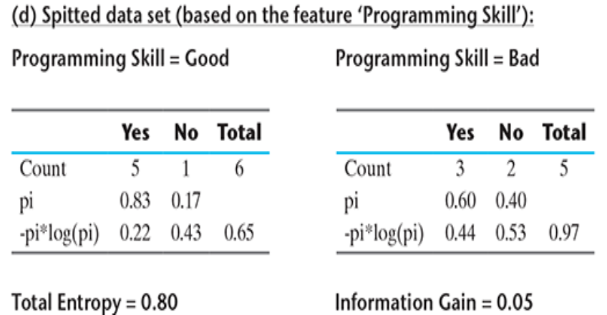

Slide 15
